Slide 1
8th International Farming System Design Conference
Palaiseau – 25-29 August 2025
Notes:
À se partager entre Marion, MH, Gentiane

Slide 2


FSD8:
Farming System Design for Sustainable Agrifood Systems: theories and practices
WELCOME ADDRESS
Alexandre PERY
Vice President, Research, Innovation and Technology Transfer
Notes:
10 minutes Maxi
MHJ
Welcome to the 8th conference of the Farming system Design community.
I am Marie-Hélène Jeuffroy ,co-organisator of this conference, researcher in agronomy here in Palaiseau.
Before entering in the content and details of organisation, I would like to invite Alexandre Pery, as the representative of the hosting organisation, to give a short welcome introduction.

Slide 3
FSD8:
Farming System Design for Sustainable Agrifood Systems: theories and practices
INTRODUCTION to FSD8
Marion Casagrande
Marie-Hélène Jeuffroy
Gentiane Maillet
Notes:
20 minutes MAXI

Slide 4
WELCOME to the 8th edition of the Farming System Design Conference
Farming System Design for Sustainable Agrifood Systems:
theories and practices
AIM:
to promote research and capacity building among stakeholders in the field of agricultural system design for the transition of agrifood systems towards health and sustainability.
Growing an interdisciplinary community for agrifood system transition
Notes:
MHJ
The specific aim of the conference is
Initially composed mainly of agronomists (crop and animal sciences), the community has expanded to include researchers in ergonomics, management, sociology, and food science, all working explicitly on designing for agri-food system transitions towards sustainability.

Slide 5





WELCOME to the 8th edition of the Farming System Design Conference
Farming System Design for Sustainable Agrifood Systems:
theories and practices
Main scientific focus of the conference: designing for agrifood system transitions towards sustainable and healthy systems
Theories, tools, practices, methods
to study, design, assess, and implement innovations to support the transition to healthy and sustainable agrifood systems
Linking agri-food system activities to design combinations of innovations for transformative change.
Change required in agricultural systems of the North and South
Promote a systems approach
Different scales of study
Plot → Farm → Landscape → Territory → Value Chain → Region → Country
Notes:
MHJ
Main scientific focus for the conference:
Theories, tools, practices, methods to understand, design, assess, and implement innovations to support the transition to healthy and sustainable agrifood systems, including Dynamics, obstacles and levers of transition.
Promote a systems approach,
Different scales for study (plot, farm, landscape, territory, value chain, region, country,…).
Change required in North and South agricultural systems,
inking agri-food system activities to design combinations of innovations for transformative change.
Links between the different activities within agrifood systems, to design combinations of innovations, needed for the deep transformation of agrifood systems.

Slide 6

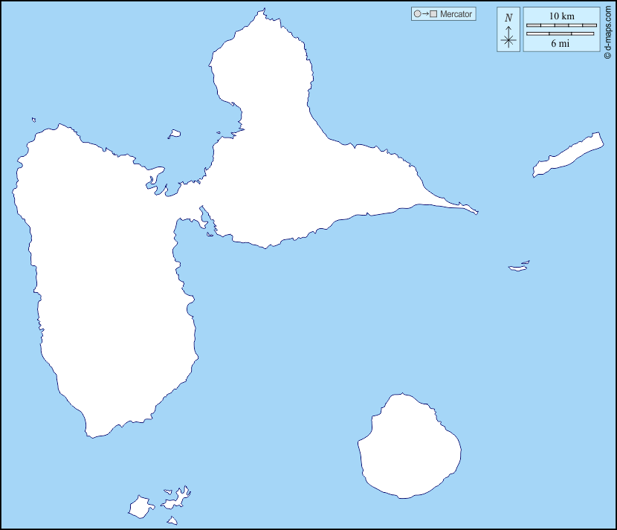
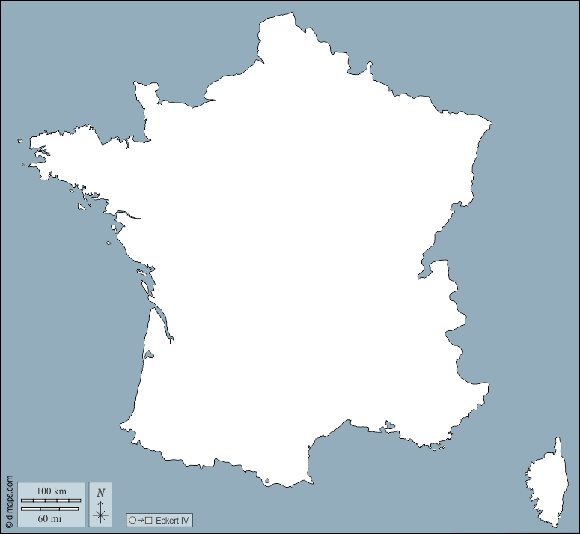


















FSD8 organisation: supported by IDEAS
IDEAS is a network of scientists (researchers, lecturers and PhD students) from around 20 INRAE Research Units in France …
Supported by AgroParisTech and INRAE (3 divisions: ACT, AgroEcoSystem and Transform) …
Focusing on innovative, open and situated design approaches to support the agroecological transition of agrifood systems toward sustainability and health…
… to tackle complex, urgent and wicked challenges by proposing solutions grounded in disruptive and systemic innovations, and by driving transformations in socio-technical systems.
UR ASSET
UR Info&Sols
UE FERLUS
UE St Laurent
de la Prée
UMR GENPHYSE
UE Maraichage
RESEARCH
A network
of more than
100 scientists
https://eng-ideas-agrifood.hub.inrae.fr/
LEARNING
initial and
continuing
education and
training
a methodological
support
PLATFORM
Notes:
MHJ
IDEAS is a network of scientists—including researchers, lecturers, and PhD students—from around 20 INRAE Research Units in France.
The network is supported by AgroParisTech and INRAE (three divisions: ACT, AgroEcoSystem, and Transform).
IDEAS focuses on innovative, open, and context-specific design approaches to support the agroecological transition of agri-food systems toward sustainability and health.
Its goal is to tackle complex, urgent, and “wicked” challenges by proposing solutions grounded in disruptive, systemic innovations and by driving transformations in socio-technical systems.

Slide 7
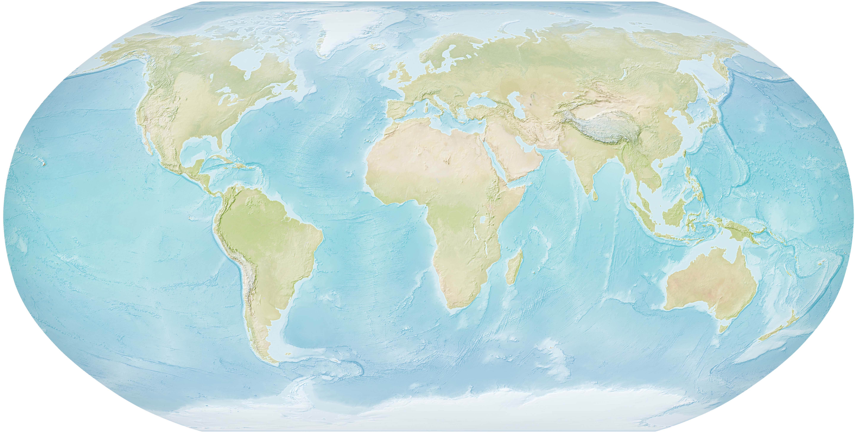
FSD trajectory: from 2007 to 2025, focus change
FSD8, aug 2025:
Palaiseau (France):
Farming System Design for Sustainable Agrifood Systems: theories and practices
FSD5, sept 2015:
Montpellier (France)
Multi-functional farming systems in a changing world
FSD2, aug 2009:
Monterey (USA)
Methodologies for Integrated Analysis of Farm Production Systems
FSD4, aug 2013 :
Lanzhou (China)
Systems research helping to meet the needs and managing the trade-offs of a changing world
FSD6, aug 2019:
Montevideo (Uruguay) Agricultural systems design sustained by nature
FSD3, sept 2011:
Brisbane (Australia)
co-organised with the 5th World Congress of Conservation Agriculture
FSD7, nov 2022:
Marrakech (Morocco)
Designing climate smart agricultural systems for a sustainable transformation of the agri-food systems of the dry areas
FSD1, sept 2007:
Catania (Italy)
Methodologies on Integrated Analysis on Farm Production Systems
Image credit: US government
Notes:
MHJ
The first conference was in Italy in 2007;
The successive conferences, every 2 or 3 years, were organised in various countries of all continents !
,with evoluting titles and contents

Slide 8
FSD trajectory: topics evolution between 2015 & 2025
 | nb of abstracts
 | 2015 | 2025
agroecological transition/agroecology | 1 | 13
agrifood systems/food | 3 | 16
co-design | 4 | 12
resilience | 3 | 9
practices | 5 | 10
innovation | 9 | 16
sustainability | 9 | 14
farmers | 12 | 18
design | 29 | 31
livestock | 18 | 16
systems | 26 | 23
production | 16 | 12
scale | 12 | 9
strategies | 12 | 9
agriculture | 8 | 6
farm | 39 | 29
assessment | 19 | 14
 | nb of abstracts
 | 2015 | 2025
Africa | 7 | 4
climate change | 8 | 4
rice | 9 | 4
cropping systems | 25 | 9
landscapes | 13 | 4
adaptation | 7 | 2
farming systems | 51 | 13
soil | 12 | 3
performance | 12 | 3
wheat | 8 | 2
model | 21 | 5
legumes | 13 | 3
ecosystem services | 7 | 1
efficiency | 7 | 1
nitrogen | 11 | 1
‘new’ topics
‘declining’ topics
‘constant’ topics
Source: abstract titles.
Term extraction performed with Cortext (managerv2.cortext.net)
Notes:
Comparing the titles of all asbtracts between 2015 and 2025 (the most easy, given the databasis we had)
We can see evolution of the scientific content:
New topics
Declining topics

Slide 9
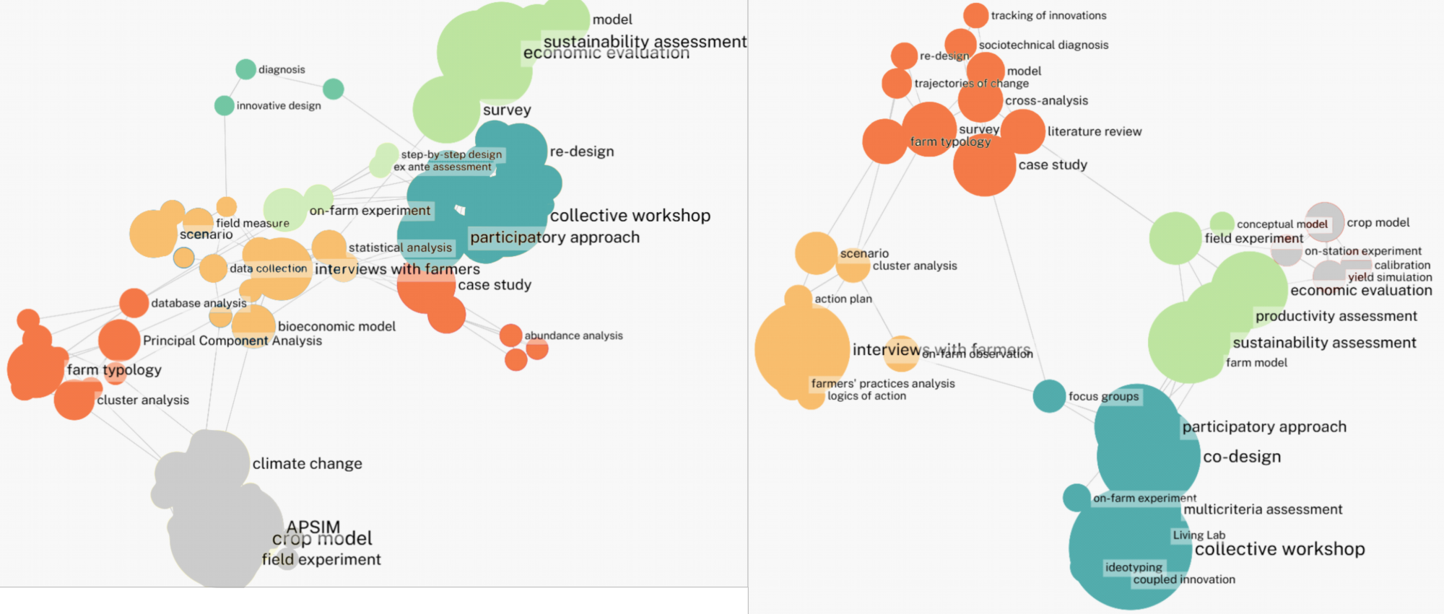
FSD trajectory: evolution in the methods
FSD - 2015
FSD - 2025
Source: Material and methods sections.
Network mapping performed with Cortext (managerv2.cortext.net)
Notes:
We also had a look at the evolution in the methods used in the abstracts, between 2015 and 2025
Crop model: perte de puissance !
Multicriteria assessment, associé à du co-design //avant, associé à model et economic !
Farmer approoach : (farm typology) → change echelle (diagnosis SST et focus sur pratiques…): cœur de la communauté FSD mais variation dans les échelles
Participatory/collective workshop: on passe de redesign à codesign: plus de collective eteval
Globalement, on retrouve les mêmes choses thématiques : modélisation, conception, approches participatives, expé
De 2015 à 2025, la modélisation avec des crop models et les expé au champ (en gris et en vert clair) prennent vraisemblablement un peu moins de place, par contre les ateliers collaboratifs ont pris de l’ampleur, de même que la co-conception (co-design) (en bleu foncé)
A la marge, émergence depuis 2025 de méthodo qui sont plus fréquemment utilisées : logiques d’action, traques aux innovations, etc. > biais de sélection (beaucoup de Saclaysiens ?) ou méthodes qui se répandent vraiment ?

Slide 10
FSD trajectory: evolution in the methods
FSD - 2015
FSD - 2025
Source: Material and methods sections.
Network mapping performed with Cortext (managerv2.cortext.net)
Notes:
Ajouter animation !!!! => MHJ A FAIRE
Crop model: far fewer abstracts are based on model ! Previously associated with experiment and climate change
Globalement, on retrouve les mêmes choses thématiques : modélisation, conception, approches participatives, expé
De 2015 à 2025, la modélisation avec des crop models et les expé au champ (en gris et en vert clair) prennent vraisemblablement un peu moins de place, par contre les ateliers collaboratifs ont pris de l’ampleur, de même que la co-conception (co-design) (en bleu foncé)
A la marge, émergence depuis 2025 de méthodo qui sont plus fréquemment utilisées : logiques d’action, traques aux innovations, etc. > biais de sélection (beaucoup de Saclaysiens ?) ou méthodes qui se répandent vraiment ?

Slide 11
FSD trajectory: evolution in the methods
FSD - 2015
FSD - 2025
Source: Material and methods sections.
Network mapping performed with Cortext (managerv2.cortext.net)
Notes:
MHJ
Multicriteria assessment, previously associated with model and economic assessment → this year associated with farm model and co-design
Globalement, on retrouve les mêmes choses thématiques : modélisation, conception, approches participatives, expé
De 2015 à 2025, la modélisation avec des crop models et les expé au champ (en gris et en vert clair) prennent vraisemblablement un peu moins de place, par contre les ateliers collaboratifs ont pris de l’ampleur, de même que la co-conception (co-design) (en bleu foncé)
A la marge, émergence depuis 2025 de méthodo qui sont plus fréquemment utilisées : logiques d’action, traques aux innovations, etc. > biais de sélection (beaucoup de Saclaysiens ?) ou méthodes qui se répandent vraiment ?

Slide 12
FSD trajectory: evolution in the methods
FSD - 2015
FSD - 2025
Source: Material and methods sections.
Network mapping performed with Cortext (managerv2.cortext.net)
Notes:
Farm approach is still a big topic but it changed : from statistical analysis (farm typology, pincipal component analysis, database analysis)… to Farmer-centered approoach : tracking of innovation,trajectories of change, survey, case study) and change of scale (socio-technical diagnosis): this focus on farmers and other actors practices is one of the key topic of FSD community
Globalement, on retrouve les mêmes choses thématiques : modélisation, conception, approches participatives, expé
De 2015 à 2025, la modélisation avec des crop models et les expé au champ (en gris et en vert clair) prennent vraisemblablement un peu moins de place, par contre les ateliers collaboratifs ont pris de l’ampleur, de même que la co-conception (co-design) (en bleu foncé)
A la marge, émergence depuis 2025 de méthodo qui sont plus fréquemment utilisées : logiques d’action, traques aux innovations, etc. > biais de sélection (beaucoup de Saclaysiens ?) ou méthodes qui se répandent vraiment ?

Slide 13
FSD trajectory: evolution in the methods
FSD - 2015
FSD - 2025
Source: Material and methods sections.
Network mapping performed with Cortext (managerv2.cortext.net)
Notes:
Ajouter animation !!!! => MHJ A FAIRE
Another main topics of FSD community is
Participatory/collective workshop: on passe de redesign à codesign: plus de collective eteval
Globalement, on retrouve les mêmes choses thématiques : modélisation, conception, approches participatives, expé
De 2015 à 2025, la modélisation avec des crop models et les expé au champ (en gris et en vert clair) prennent vraisemblablement un peu moins de place, par contre les ateliers collaboratifs ont pris de l’ampleur, de même que la co-conception (co-design) (en bleu foncé)
A la marge, émergence depuis 2025 de méthodo qui sont plus fréquemment utilisées : logiques d’action, traques aux innovations, etc. > biais de sélection (beaucoup de Saclaysiens ?) ou méthodes qui se répandent vraiment ?

Slide 14
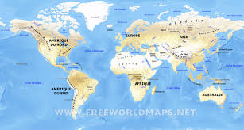
FSD trajectory: attendees
Country | 2025 | 2022 Morocco | 2019 Uruguay | 2015 France | 2009 USA
TOT AMERICA | 10 | 5 | 94 | 38 | 39
Uruguay | 5 | 1 | 72 | 13 | 2
Mexico | 3 | 1 | 5 | 3 | 0
USA | 1 | 2 | 3 | 10 | 32
Costa Rica | 0 |  |  | 4 | 1
Argentina | 0 | 1 | 6 | 3 | 0
Brazil | 0 |  | 4 | 1 | 0
Colombia |  |  | 1
chile |  |  | 1
Nicaragua | 0 |  |  | 1 | 0
Canada | 1 |  | 2 | 3 | 4
Country | 2025 | 2022 Morocco | 2019 Uruguay | 2015 France | 2009 USA
TOTAL | 228 | 66 | 185 | 327 | 138
Country | 2025 | 2022 Morocco | 2019 Uruguay | 2015 France | 2009 USA
TOT ASIA | 10 | 2 | 20 | 28 | 7
China | 4 |  | 16 | 15 | 0
India | 3 | 1 | 2 | 4 | 3
Indonesia | 2 |  |  | 2 | 0
Lebanon | 1 | 1 |  | 1 | 0
Saudi Arabia | 0 |  |  | 0 | 1
Malaysia | 0 |  |  | 2 | 0
Nepal | 0 |  | 1 | 1 | 0
Bengladesh |  |  | 1
South Korea | 0 |  |  | 2 | 0
Japan | 0 |  |  | 1 | 3
Country | 2025 | 2022 Morocco | 2019 Uruguay | 2015 France | 2009 USA
TOT AFRICA | 10 | 41 | 20 | 21 | 1
Tunisia | 3 | 5 |  | 1 | 0
Senegal | 2 | 2 | 4 | 3 | 0
Burkina Faso | 1 |  | 1 | 2 | 0
Ethiopia | 1 | 1 |  | 0 | 0
Madagascar | 1 |  | 1 | 1 | 0
Mali | 1 |  |  | 0 | 0
Nigeria | 0 |  | 7 | 1 | 1
Benin | 0 |  |  | 2 | 0
Zimbabwe |  |  | 1
Cameroon | 0 |  |  | 3 | 0
Chad | 0 |  |  | 1 | 0
Egypt | 0 | 3 |  | 1 | 0
Kenya | 0 | 1 | 3 | 1 | 0
Morocco | 0 | 29 |  | 1 | 0
Congo |  |  | 1
Ghana |  |  | 1
Togo | 0 |  |  | 1 | 0
Uganda |  |  | 1
Ivory Coast | 0 |  |  | 3 | 0
Malawi | 1 |  |  | 0 | 0
Country | 2025 | 2022 Morocco | 2019 Uruguay | 2015 France | 2009 USA
TOT EUROPE | 195 | 17 | 39 | 210 | 70
France | 146 | 12 | 24 | 150 | 46
Netherlands | 23 | 1 | 13 | 20 | 4
Germany | 9 | 1 | 2 | 12 | 9
Belgium | 8 |  |  | 9 | 0
Italy | 4 |  |  | 3 | 8
Sweden | 2 |  |  | 2 | 0
Denmark | 1 |  |  | 4 | 0
Portugal | 0 | 2 |  | 0 | 0
Spain | 1 |  |  | 2 | 0
UK | 1 | 1 |  | 4 | 0
Hungary | 0 |  |  | 0 | 1
Czech Republic | 0 |  |  | 2 | 1
Poland | 0 |  |  | 0 | 1
Norway | 0 |  |  | 2 | 0
Switzerland | 0 |  | 1 | 3 | 0
Ireland | 1 |  |  | 0 | 0
Country | 2025 | 2022 Morocco | 2019 Uruguay | 2015 France | 2009 USA
TOT OCEANIA | 2 | 1 | 9 | 17 | 21
Australia | 1 | 1 | 4 | 16 | 16
New Zealand | 1 |  | 5 | 1 | 5
Notes:
Les plus assidus + les effets pays d’accueil + les tendances (augmentation/stable/diminution) !!
Australiens : à l’IFSA !!!
Enlever les 0 ?
Carte dans le milieu +

Slide 15
FSD trajectory: number of attendees
Year Country | 2025 France | 2022 Morocco | 2019 Uruguay | 2015 France | 2009 USA
TOTAL | 228 | 66 | 185 | 327 | 138
Notes:
MHJ
Total :this year is a good year, with near 230 attendees
Par continent :
Base stable: Europe + effet pays organisateur
Continuer àavoir ouverture internationale !!
Seulement les totaux par continent
Les plus assidus + les effets pays d’accueil + les tendances (augmentation/stable/diminution) !!
Carte dans le milieu +

Slide 16
FSD trajectory: number of attendees
Year Country | 2025 France | 2022 Morocco | 2019 Uruguay | 2015 France | 2009 USA
TOTAL | 228 | 66 | 185 | 327 | 138
Year Country | 2025 France | 2022 Morocco | 2019 Uruguay | 2015 France | 2009 USA
TOT EUROPE | 195 | 17 | 39 | 210 | 70
Year Country | 2025 France | 2022 Morocco | 2019 Uruguay | 2015 France | 2009 USA
TOT AMERICA | 10 | 5 | 94 | 38 | 39
Year Country | 2025 France | 2022 Morocco | 2019 Uruguay | 2015 France | 2009 USA
TOT ASIA | 10 | 2 | 20 | 28 | 7
Country | 2025 France | 2022 Morocco | 2019 Uruguay | 2015 France | 2009 USA
TOT OCEANIA | 2 | 1 | 9 | 17 | 21
Year Country | 2025 France | 2022 Morocco | 2019 Uruguay | 2015 France | 2009 USA
TOT AFRICA | 10 | 41 | 20 | 21 | 1
Notes:
MHJ
If we look at the origin of the attendees, by continent,
We observe first a stable and high contribution of Europe, even when the conference is in another continent !
then we see a strong influence of the organising country
Continuer à avoir ouverture internationale !!
Seulement les totaux par continent
Les plus assidus + les effets pays d’accueil + les tendances (augmentation/stable/diminution) !!
Carte dans le milieu +

Slide 17
FSD trajectory: number of attendees
Year Country | 2025 France | 2022 Morocco | 2019 Uruguay | 2015 France | 2009 USA
TOTAL | 228 | 66 | 185 | 327 | 138
Year Country | 2025 France | 2022 Morocco | 2019 Uruguay | 2015 France | 2009 USA
TOT EUROPE | 195 | 17 | 39 | 210 | 70
Year Country | 2025 France | 2022 Morocco | 2019 Uruguay | 2015 France | 2009 USA
TOT AMERICA | 10 | 5 | 94 | 38 | 39
Year Country | 2025 France | 2022 Morocco | 2019 Uruguay | 2015 France | 2009 USA
TOT ASIA | 10 | 2 | 20 | 28 | 7
Country | 2025 France | 2022 Morocco | 2019 Uruguay | 2015 France | 2009 USA
TOT OCEANIA | 2 | 1 | 9 | 17 | 21
Year Country | 2025 France | 2022 Morocco | 2019 Uruguay | 2015 France | 2009 USA
TOT AFRICA | 10 | 41 | 20 | 21 | 1
Notes:
MHJ
If we look at the origin of the attendees,by continent,
We observe first a stable and high contribution of Europe, even when the conference is in another continent !
then we see a strong influence of the organising country
We hope to maintain an international audience, even larger !

Slide 18
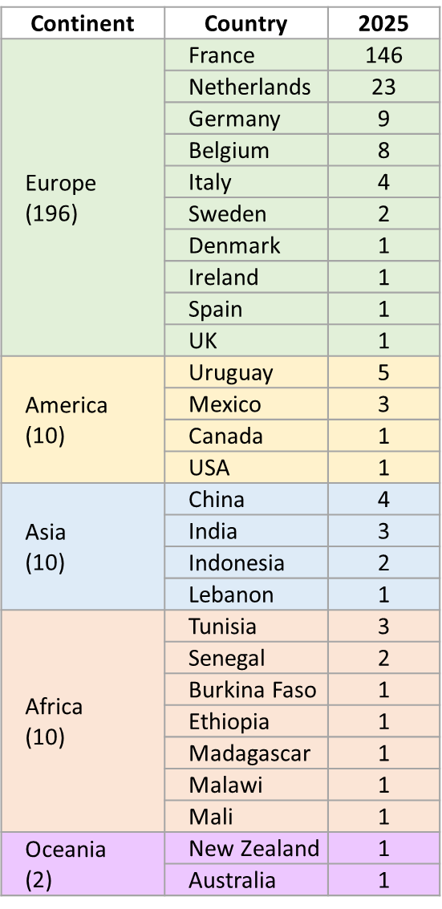




FSD 8 : Who is attending this year?
Please stand up if your coming from :
  Asia
  Oceania
  Africa
  America
  Europe
Please raise your hand if you are:
An agronomist
An animal scientist
An economist
A social or human scientist
A food scientist
Other type of scientist
Please stand up if you are a PhD Student!
46 PhD students
(20% of attendees)
Please stand up if you are a vegetarian or vegan!
71/228
(31% of attendees)
Please raise your hand if you have already attended
A side event
The training course
62/228
(27% of attendees)
Women/Men:
134/94 = 59% / 41%
Notes:
Marion
Diapo pour faire se lever les gens !
A chaque fois question, on fait se lever/lever la main puis réponse et ainsi de suite
Stand up when I call your continent. Sit down after everyone from your continent is standing.
On peut éventuellement enlever le dernier traning course/side event si on veut gagner du temps

Slide 19
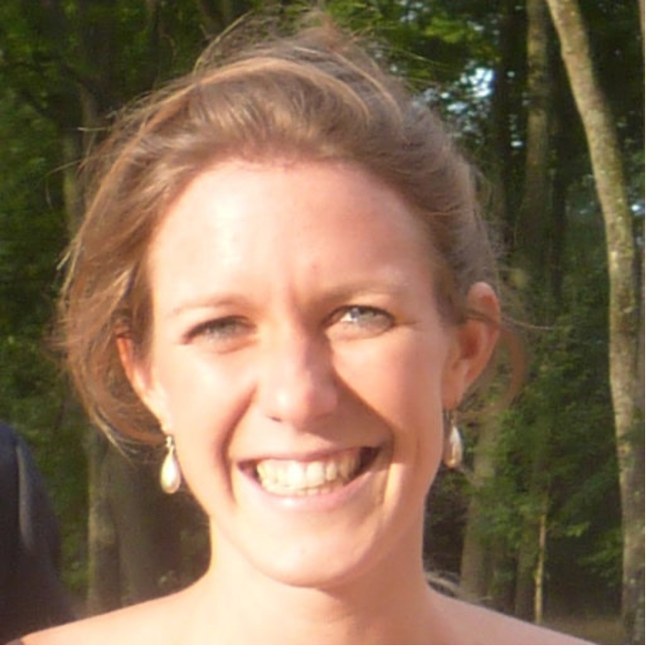
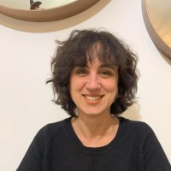
FSD8 organisation: training course already completed …
40 trainees & 12 speakers, from 13 countries
An introduction to the theories and methods of design for agrifood systems transition in the making.
Participants have explored the relationships between “design,” “agrifood systems transition,” and “in the making” through :
  a variety of theoretical frameworks
  diverse methods and tools to analyze, engage in, or support these design processes
  resources (experts, references, etc.) and guidance on how to apply them within participants’ own research programs
Special thanks to Chloé Salembier and Lorène Prost for organizing this course!
Notes:
Marion
40 trainees and 12 speakers from 13 countries participated.
This course provided an introduction to the theories and methods of design for agrifood systems transitions in the making.
Participants explored the relationships between “design,” “agrifood systems transition,” and “in the making” through:
A variety of theoretical frameworks
Diverse methods and tools to analyze, engage in, or support these design processes
Resources (experts, references, etc.) and guidance on how to apply them within participants’ own research programs
Special thanks to Chloé Salembier and Lorène Prost for organizing this course!

Slide 20


FSD8 organisation: PROGRAM
Two work and meeting rooms are located in Building C1 and are available for use at any time
(C1.4.24 & C1.4.27)
Notes:
Marion
Program Overview
The program alternates between plenary sessions and parallel sessions, as well as social activities such as cocktail, field trips and social event in Versailles. This combination allows for both scientific exchanges and more informal networking opportunities.
You can quickly access the full program via the QR code or view it displayed in the hall.

Slide 21
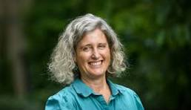

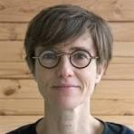

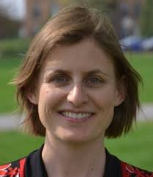
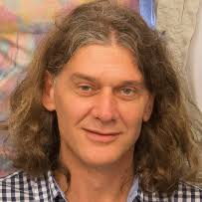
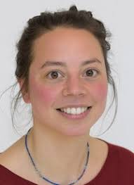
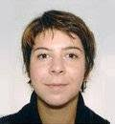
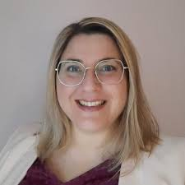
FSD8 organisation: 7 invited key-notes to cover the main topics!
Rachel Bezner-Kerr : Agroecological food system design across Global North and South contexts: challenges and methods
Philippe Baret : Accelerating the transition: a multi-scale approach
Chaired by Eric Scopel (CIRAD, France-Brazil)
Katrien Deeschemaeker, Marie-Hélène Jeuffroy, Jean-Marc Meynard, Jacques Wéry: Transitioning to sustainable agri-food systems: going beyond the systems rhetoric
Chloé Lecomte and Elsa Berthet : Agriculture by Design : how to address differently agriculture challenges
Chaired by Boelie Elzen (WUR, The Netherlands)
Santiago Dogliotti, Walter Rossing : Farming Systems Design for Agroecological Transitions: which methods ?
Roos Adelhart Toorop and Laure Hossard : From Concept to Practice: Exploring the Promise and Pitfalls of Resilience in Farming Systems Design
Caroline Pénicaud : Breaking Silos: Integrating Food Science and Agronomy for Systemic Change
Chaired by Shalander Kumar (ICRISAT, India) and Hatem Belhouchette (IAMM, France)
THANKS TO ALL OF THEM !
Notes:
marion

Slide 22
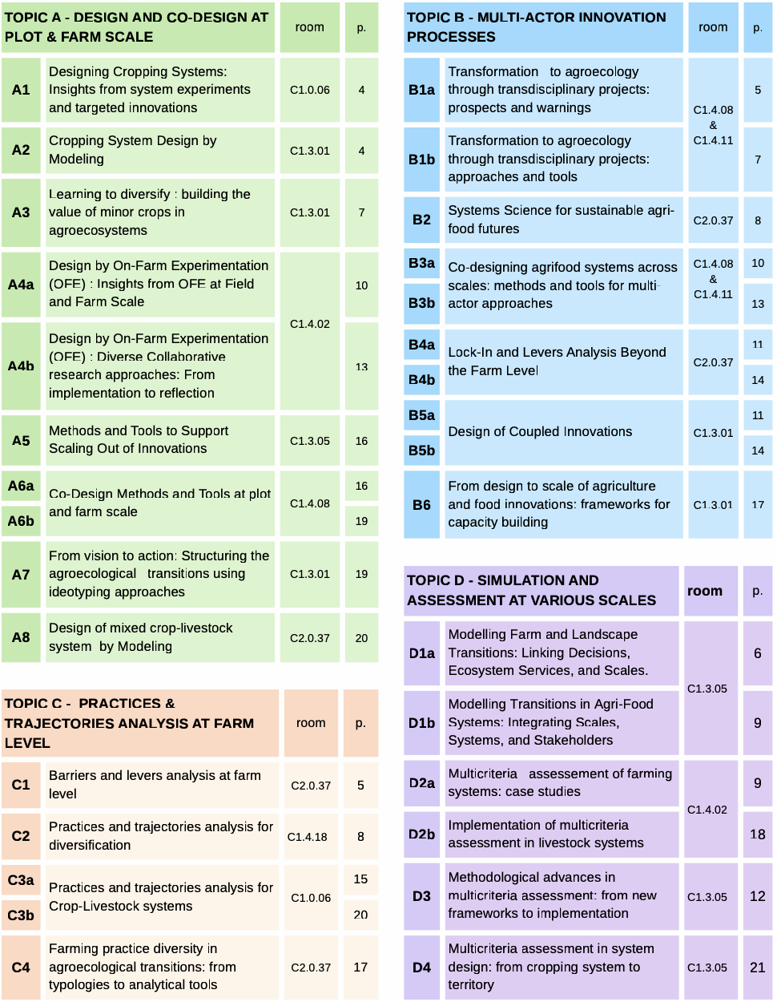


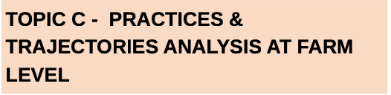

FSD8 organisation: plenty of insightful talks!
217 abstracts received
→ 176 abstracts presented
Distributed among 4 main topics
and 22 thematic sessions
Notes:
Marion
On a fleché dans les batiments.
Dans chaque salle: liste des sessions de toute la semaine (avec interventions)
Programme affiché dans le hall et sur le site web.

Slide 23
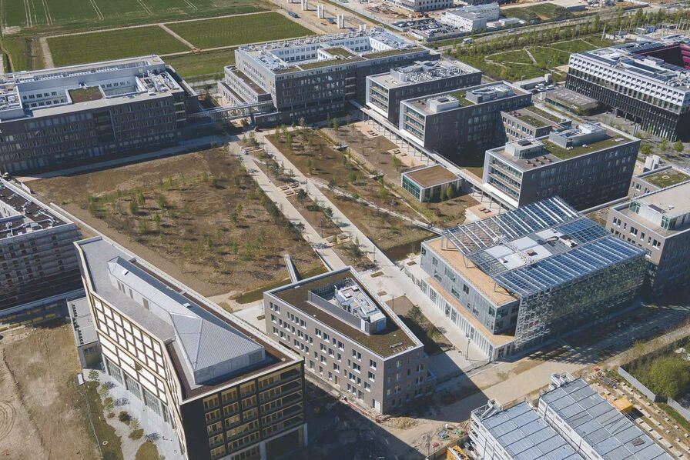
Practical information: map of the campus
Parallel Sessions
Building C2
Floor 0
Parallel Sessions
Building C1
(Floors 0 – 1 – 3 – 4)
Working rooms
Building C1
(Floor 4)
Find all conference info in the hall:
program
session rooms
coffee breaks
meal locations
Building A-B
Plenary sessions
Meal locations
Main entrance
Notes:
Marion
Follow the signs around campus to reach the program locations

Slide 24
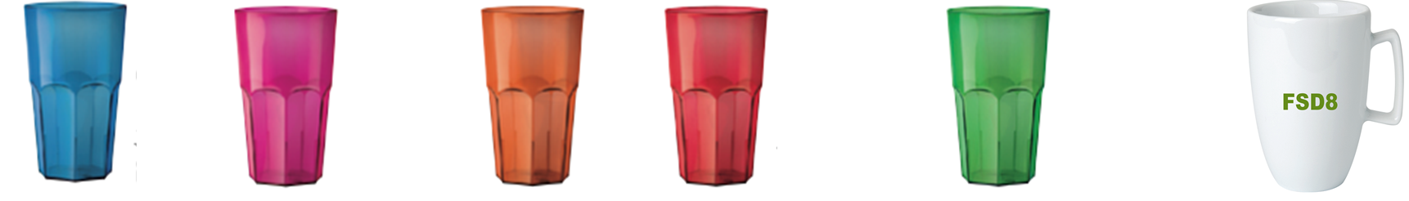
Practical information
Use the glass and cup in your tote bag at every coffee break… and take them home!!
Wifi code: Behind your name in your badge, you have a personal internet code.
Keep it safe, don’t share it, and use it all week. Need a new one? Just ask!
Power outlets: No outlets in session rooms ➔ charge your laptops under the auditorium seats.
Notes:
Gentiane

Slide 25
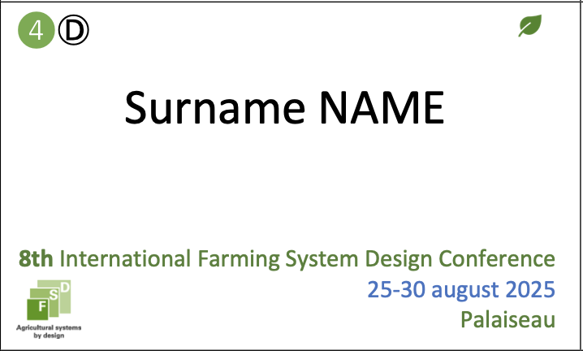
Practical information
Your badge contains important info – keep it with you all week
and YOU NEED IT to enter the venue every day.
Number of the field trip you were assigned to
Special diet if you requested one
Institution - Country
the letter indicates the group you were assigned to for the Versailles visit
Notes:
gentiane

Slide 26
Practical information
5. Conference information is available on the website:
This introductory presentation
Several surveys we will discuss late
6. Group photo
This afternoon, after the last session
Be ready in the hall at 18:00
7. Cloakroom & Luggage Storage
Today: collect your suitcase after the welcome cocktail
Friday: open before the morning sessions, at midday, and at 15:00
Need access outside these hours? A phone number is provided on the room door
8. Field trips
We selected farms with processing units
Products may be available for purchase at most farms
Bus departure: tomorrow, Wednesday, just after lunch at 13:30
Notes:
gentiane
7. Suitcase Room:
Today: collect your suitcase after the welcome cocktail
Friday: open before the morning sessions, at midday, and at 15:00
Need access outside these hours? A phone number is provided
8. Field Trips:
We selected farms with processing units
Products may be available for purchase at each farm (to be confirmed)
Departure: tomorrow, Wednesday, just after lunch at 13:45

Slide 27





FSD8 organisation: social events
Welcome Cocktail
Tonight from 18:00 onwards
on campus, with a brass band
Social Event - Thursday 28th from 15:30
Bus Schedule:
  Departure: from the conference venue at 15:30
  Return: from the restaurant at 22:00, 22:30, or 23:00
Buses will stop at the conference venue and Massy-Palaiseau station
Guided tour of the Potager du Roi and Quartier Saint-Louis in Versailles
Dinner at La Flottille restaurant
Dress code: “Sunshine in Versailles”
Notes:
ATTENTIOn If you’re coming by car, please let us know and give us your license plate number by the end of The day (TODAY)

Slide 28
FSD8 commitment: eco-friendly initiatives for a greener Conference
Catering from local, seasonal producers
Organic and vegetarian options available
Recyclable or reusable tableware
Eco-cups and mugs to reduce single-use plastic at coffee breaks
Goodies produced in Europe, organic if possible
Gas-powered buses for travel
Digital program, abstracts, and presentation
Notes:
Gentiane

Slide 29

FSD8 publications: book of abstracts and presentations
All FSD8 abstracts are in the
Book Of Abstracts, with a unique doi:
https://doi.org/10.17180/j9xc-fs91
Available
Preliminary version on the FSD8 website: https://fsd8-2025.symposium.inrae.fr/
on the Hal platform:
https://hal.inrae.fr/hal-05219264

Slide 30
FSD8-linked Issues of scientific journals
1/ Agricultural Systems: a Special Issue
Theme: Design for agrifood system transitions: theory and practice
Guest Editors to be confirmed
Call for Papers: Opening soon
Submissions Deadline: 31st December 2026
2/ Agronomy for Sustainable Development: a Virtual Issue
Theme: Cropping and livestock system design: actor-oriented approach
Guest Editors to be confirmed
Call for Papers: Opening soon
Submissions Deadline: 31st December 2026
3/ Italian Journal of Agronomy
Proposed theme: Cropping and livestock system design by experiment
Special Issue: Pending confirmation
Note: Papers can be submitted, but special issue to be confirmed
Notes:
MHJ
Italian:experimental and theoretical contributions to agronomy and crop science. The journal deals with all aspects of Agricultural and Environmental Sciences, the interactions between cropping systems and sustainable development. Multidisciplinary articles that bridge agronomy with ecology, environmental and social sciences are also welcome.
1/ Agricultural Systems : Design for agrifood system transitions: theory and practice
Proposed guest editors:
Chloé Lecomte (CIRAD, France), 👍
Katrien Deeschemaeker (WUR, NL) 👍
Margot Leclère (INRAE, France)
Call for papers opening soon ; Submissions open until : 31st December 2026
2/ Agronomy For Sustainable Development: Cropping and livestock system design : actor-oriented approach
Proposed guest editors:
Mariana Scarlato (Uruguay) 👍
Mireille Navarrete (France) ;
Esther Ronner (WUR) : NON
Call for papers opening soon ; Submissions open until : 31st December 2026
3/ Italian Journal of Agronomy : Cropping and livestock system design by experiment
pending confirmation for a Special Issue
on peut soumettre des papiers mais N° special ???
??????????

Slide 31

What could happen after FSD8 conference ?
FSD1, sept 2007: Catania (Italy)
FSD2, 2009: Monterey (USA)
FSD3, sept 2011: Brisbane (Australia),
FSD4, aug 2013 : Lanzhou (China),
FSD5, sept 2015: Montpellier (France)
FSD6, aug 2019: Montevideo (Uruguay)
FSD7, nov 2022: Marrakech (Morocco)
FSD8, aug 2025: Palaiseau (France)
FSD9: When ? Where ? What would be the main topic?
Would you like to host the 9th edition of FSD?
Any candidate? Please discuss during the conference and share your proposal with the FSD8 organization team
We will return to this point in the conclusion (Friday).
Notes:
MHJ

Slide 32

What could happen after FSD8 conference ?
Permanent FSD Board & Association
What do you think of creating a permanent board or association for FSD? Please share your answer with the QR code
Between FSD8 and FSD9:
Would you like to maintain regular scientific exchange within the FSD community?
  Scientific webinars to facilitate logistics
  Frequency: 4 webinars per year? Other suggestions?
  Content: Share finalized PhD theses or completed projects? Other ideas?
  Organisation: A group of 4 young scientists from various countries?
Interested to manage? Please let us know by filling the on-line survey on the FSD8 website
Other ideas?
Please send an email to fsd8@inrae.fr
Notes:
MHJ
FSD9 Conference: When? Where?
Would you like to host the 9th edition of FSD?
Any candidate? Please discuss during the conference and share your proposal with me – we will return to this point in the conclusion (Friday).
Voting during the conference? (via site/poster)
Permanent FSD Board & Association
What do you think of creating a permanent board or association for FSD?
Between FSD8 and FSD9:
Would you like to maintain regular scientific exchange within the FSD community?
Scientific webinars to facilitate logistics
Frequency: 4 webinars per year? Other suggestions?
Content: Share finalized PhD theses or completed projects? Other ideas?
Organisation: A group of 4 young scientists from various countries?
Interested? Please let me know during the conference (sign-up via site/poster)
Other ideas?
Propose them during the conference (via site/poster)

Slide 33

THANKs to the funding organisations
INRAE Divisions:
  ACT
  AgroEcoSystem
  Transform
INRAE Research Units:
  UMR Agronomie
  UMR SADAPT
  UMR EcoSys
INRAE Administration: International Relations Department (invited keynote speakers and support for participants from Southern countries)
AgroParisTech: Higher Education Institution in Life and Environmental Sciences & Technologies
Université Paris-Saclay: Graduate School Biosphera
Notes:
MHJ
INRAE divisions : ACT, AgroEcoSystem, Transform
INRAE research units : UMR Agronomie, UMR SADAPT
INRAE administration : DRI (invited key-note speakers and support for participants from South countries)
AgroParisTech: high school on Life and environmental sciences and technologies
Université Paris-Saclay: Graduate School Biosphera

Slide 34
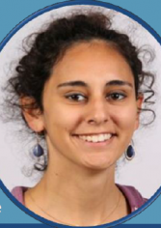
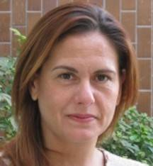
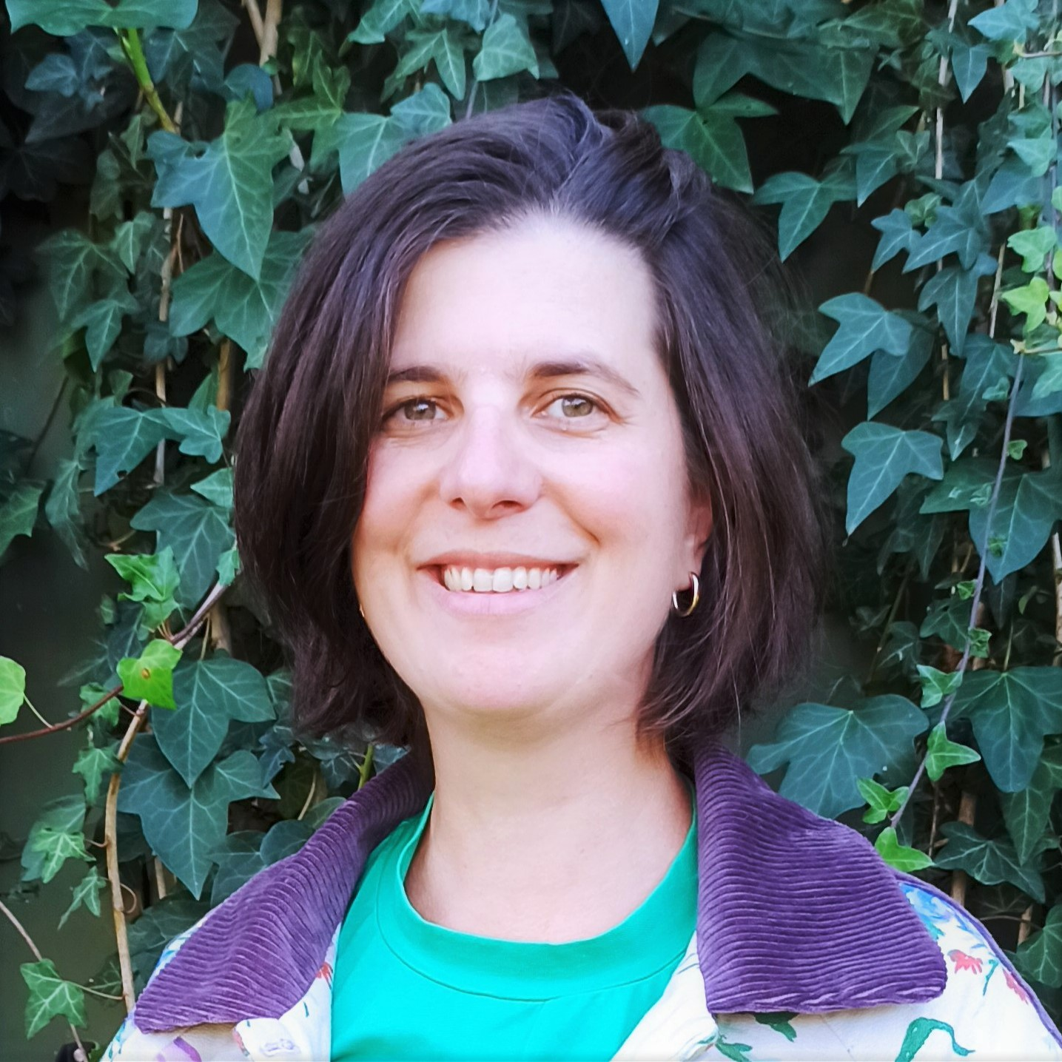
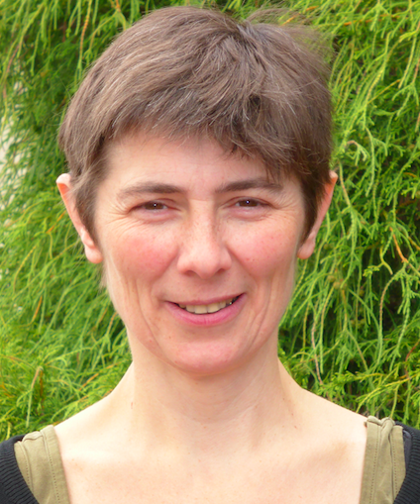
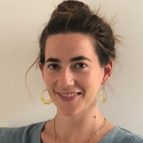

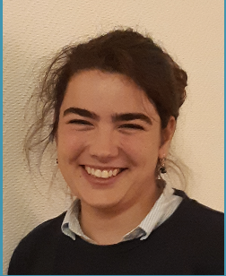
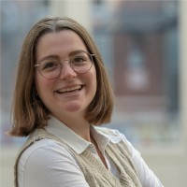
The organising team: Need help? Just ask us!
Gentiane
MAILLET
Sophie
FORMISANO
Marion
CASAGRANDE
Marie-Hélène
JEUFFROY
Jeanne
CADIOU
Thibault
LEFEUVRE
Herminie
MEYNARD
Lisa
MORISON
Notes:
On fait monter tout le monde si possible ! S’ils sont au 1er rang !!!!!

Slide 35
Farming System Design 8 Conference
Farming System Design for Sustainable Agrifood Systems: theories and practices
We wish you a fruitful, rich, innovative conference !

Slide 36
8th International Farming System Design Conference
Palaiseau – 25-29 August 2025

Slide 37
FSD trajectory: from 2007 to 2025, focus change
FSD1, sept 2007: Catania (Italy): Methodologies on Integrated Analysis on Farm Production Systems
FSD2, aug 2009: Monterey (USA): Methodologies for Integrated Analysis of Farm Production Systems
FSD3, sept 2011: Brisbane (Australia): co-organised with the 5th World Congress on Conservation Agriculture
FSD4, aug 2013 : Lanzhou (China): Systems research helping to meet the needs and managing the trade-offs of a changing world
FSD5, sept 2015: Montpellier (France): Multi-functional farming systems in a changing world
FSD6, aug 2019: Montevideo (Uruguay): Agricultural systems design sustained by nature
FSD7, nov 2022: Marrakech (Morocco): Designing climate smart agricultural systems for a sustainable transformation of the agri-food systems of the dry areas
FSD8, aug 2025: Palaiseau (France): Farming System Design for Sustainable Agrifood Systems: theories and practices
Notes:
Démarré en 2007
Évolution dans les titres, focus liés au pays d’accueil

Slide 38
FSD8 organisation: supported by IDEAS
IDEAS = 3 synergistic areas to support innovative design and transitions
towards healthy and sustainable agrifood systems
Produce knowledge and develop methods and approaches on and for the transformation of socio-technical systems and on innovative, open, and situated design on and for transitioning agrifood systems.
Raise awareness about design.
Share our knowledge, tools, methods, and expertise.
Develop the design skills of students and innovation stakeholders.
RESEARCH
A network
of more than
100 scientists
Formalizing and mobilizing (after adaptation to the situation) design methods and associated know-how to support and equip innovation stakeholders for their transition.
LEARNING
initial and
continuing
education and
training
a methodological
support
PLATFORM
Notes:
Suppr cette diapo→mettre les 3 ronds dans la précédente
Réduire lacarte de France

Slide 39
FSD trajectory: all authors
Country | 2015 | 2025
Malaysia | 1 | 0
Mongolia | 1 | 0
New Zealand | 1 | 3
Nigeria | 1 | 1
Norway | 1 | 0
Philippines | 1 | 0
Romania | 1 | 0
South Africa | 1 | 2
Thailand | 1 | 0
Tunisia | 1 | 5
Uganda | 1 | 0
Tanzania | 1 | 1
Zambia | 1 | 0
Greece | 0 | 2
Mozambique | 0 | 2
Bangladesh | 0 | 1
Bulgaria | 0 | 1
Colombia | 0 | 1
Egypt | 0 | 1
Hungary | 0 | 1
Lebanon | 0 | 1
Mali | 0 | 1
Peru | 0 | 1
Poland | 0 | 1
Portugal | 0 | 1
Qatar | 0 | 1
Rwanda | 0 | 1
Sri Lanka | 0 | 1
Vietnam | 0 | 1
Country | 2015 | 2025
France | 116 | 130
Australia | 25 | 1
Netherlands | 23 | 34
Germany | 13 | 17
United States | 13 | 6
Uruguay | 12 | 7
Belgium | 11 | 7
China | 10 | 7
Italy | 9 | 7
Zimbabwe | 9 | 5
Costa Rica | 8 | 0
India | 7 | 4
Mexico | 7 | 7
Switzerland | 7 | 2
Canada | 6 | 2
Argentina | 5 | 1
Cameroon | 5 | 0
Spain | 5 | 4
Burkina Faso | 4 | 0
Côte D’Ivoire | 4 | 2
Ethiopia | 4 | 4
Indonesia | 4 | 1
Country | 2015 | 2025
Kenya | 4 | 4
Nicaragua | 4 | 0
Sweden | 4 | 4
United Kingdom | 4 | 4
Benin | 3 | 2
Brazil | 3 | 2
Denmark | 3 | 7
Malawi | 3 | 2
Senegal | 3 | 5
Cambodia | 2 | 0
Ghana | 2 | 1
Jordan | 2 | 0
Madagascar | 2 | 2
Morocco | 2 | 7
South Korea | 2 | 0
Algeria | 1 | 0
Burundi | 1 | 0
Czechia | 1 | 0
Finland | 1 | 0
Iran | 1 | 0
Ireland | 1 | 3
Japan | 1 | 0
Notes:
Trop gros travail de faire sur 2007 et 2019 –> supprimé !
À garder ???
Tous auteurs OU attendees !!
Cf commentaires
En %???

Slide 40
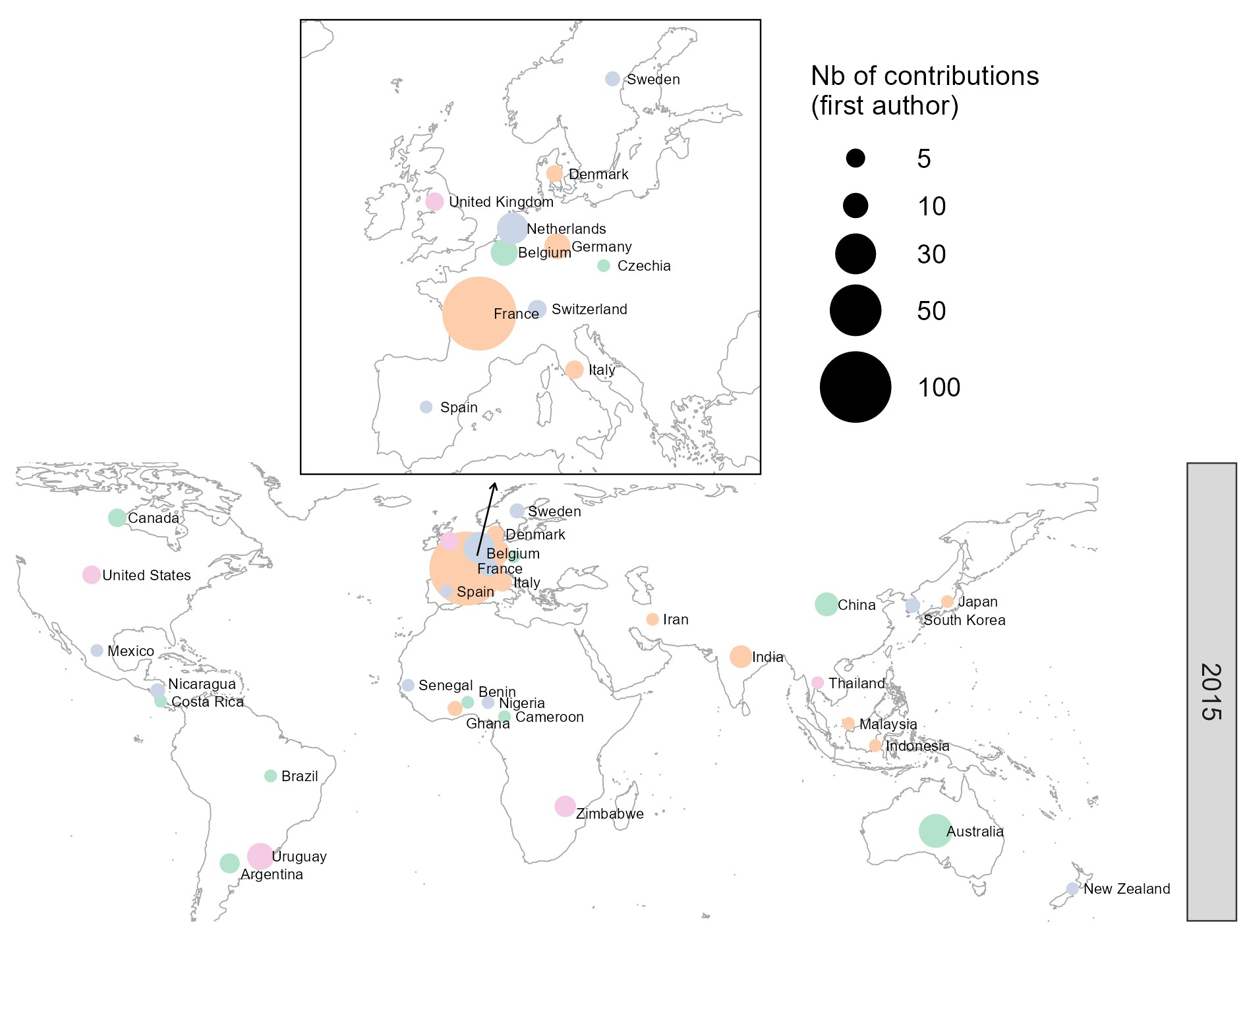
FSD trajectory: first authors
Source: first author affiliation. Maps created with ggplot2 R package

Slide 41
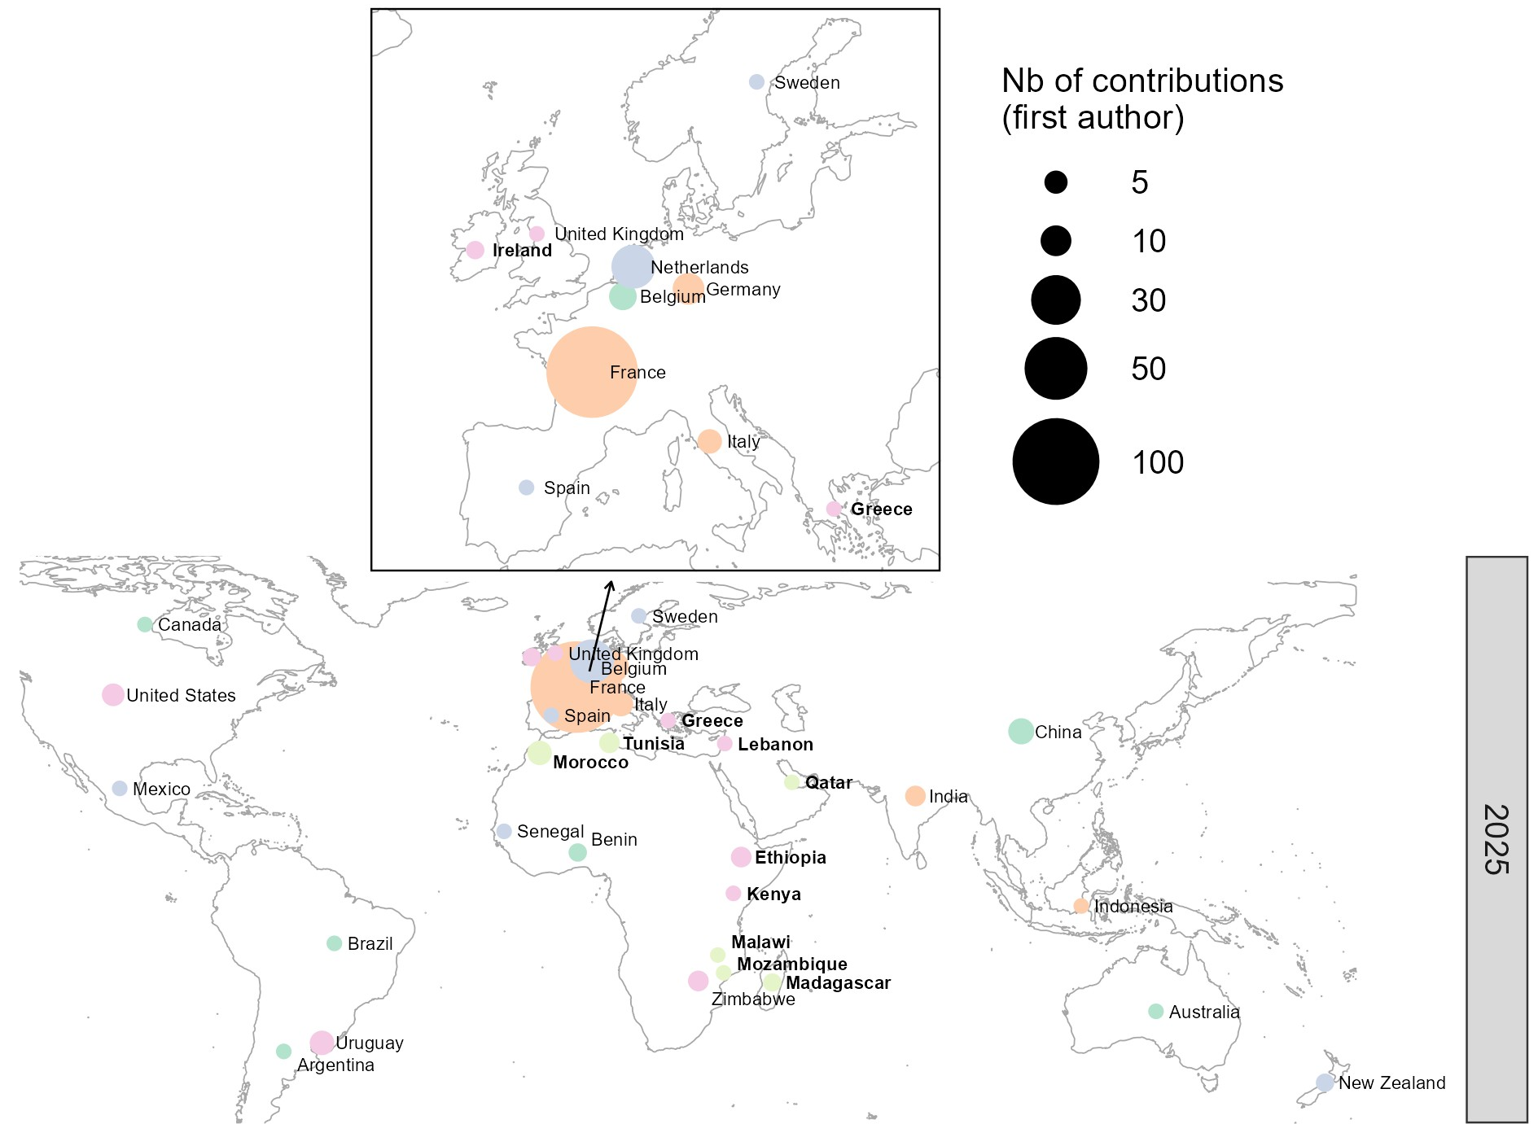
FSD trajectory: first authors
Source: first author affiliation. Maps created with ggplot2 R package

Slide 42
FSD trajectory: first authors
Country | 2025 | 2019 | 2015 | 2007
Indonesia | 1 | 0 | 1 | 0
Iran | 0 | 0 | 1 | 5
Japan | 0 | 0 | 1 | 2
Malaysia | 0 | 0 | 1 | 0
Mexico | 1 | 5 | 1 | 3
New Zealand | 2 | 3 | 1 | 0
Nigeria | 0 | 1 | 1 | 1
Senegal | 1 | 3 | 1 | 1
Spain | 1 | 0 | 1 | 3
Thailand | 0 | 0 | 1 | 0
Morocco | 5 | 0 | 0 | 0
Ethiopia | 3 | 1 | 0 | 1
Tunisia | 3 | 0 | 0 | 0
Ireland | 2 | 0 | 0 | 2
Madagascar | 2 | 0 | 0 | 0
Greece | 1 | 0 | 0 | 0
Kenya | 1 | 2 | 0 | 2
Lebanon | 1 | 0 | 0 | 0
Malawi | 1 | 0 | 0 | 0
Mozambique | 1 | 0 | 0 | 0
Qatar | 1 | 0 | 0 | 0
South Africa | 0 | 0 | 0 | 3
Bangladesh | 0 | 1 | 0 | 1
Israel | 0 | 0 | 0 | 1
Mali | 0 | 0 | 0 | 1
Poland | 0 | 0 | 0 | 1
Portugal | 0 | 0 | 0 | 2
Chile | 0 | 2 | 0 | 0
Uganda | 0 | 2 | 0 | 0
Sudan | 0 | 0 | 0 | 2
Country | 2025 France | 2019 Uruguay | 2015 France | 2007 Sicilia
TOTAL | 215 | 122 | 328 | 222
France | 111 | 23 | 107 | 41
Australia | 1 | 3 | 19 | 15
Netherlands | 22 | 14 | 16 | 19
Belgium | 7 | 1 | 11 | 4
Uruguay | 5 | 37 | 11 | 0
Germany | 10 | 1 | 10 | 8
China | 6 | 6 | 8 | 2
India | 3 | 3 | 7 | 6
Zimbabwe | 3 | 1 | 6 | 1
Argentina | 1 | 5 | 5 | 2
Canada | 1 | 2 | 4 | 3
Italy | 5 | 0 | 4 | 56
Switzerland | 0 | 0 | 4 | 8
UK | 1 | 0 | 4 | 7
USA | 4 | 0 | 4 | 14
Denmark | 0 | 0 | 3 | 4
Ghana | 0 | 0 | 2
Nicaragua | 0 | 0 | 2
South Korea | 0 | 0 | 2
Sweden | 1 | 4 | 2 | 2
Benin | 2 | 0 | 1
Brazil | 1 | 1 | 1
Cameroon | 0 | 0 | 1
Costa Rica | 0 | 0 | 1
Burkina Faso | 0 | 1 | 0 | 0
Czechia | 0 | 0 | 1
Notes:
Mettre le pays aussi !
Les plus assidus + les effets pays d’accueil + les tendances (augmentation/stable/diminution) !!
Australiens : à l’IFSA !!!
Monterey ???
Voir Maroc????
Mettre en évidence pays du Sud ???
Grouper par continent???? Europe, Amérique latine, Amérique du Nord, Océanie, Afrique, Asie
Enlever les 0
Mettre des couleurs
Carte dans le milieu +

Slide 43

FSD8 organisation: already a training course …
41 participants
An introduction to the theories and methods of design for agrifood systems transition in the making.
explore the relationships between “design,” “agrifood systems transition,” and “in the making” through :
  a variety of theoretical frameworks
  diverse methods and tools to analyze, engage in, or support these design processes
  resources (experts, references, etc.) and guidance on how to leverage them within participants’ own research programs
Thank you to Chloé Salembier and Lorène Prost, who organized this course !
Notes:
Les mettre dans les remerciements à la fin !!!!

Slide 44
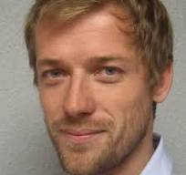
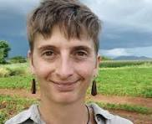
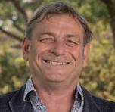
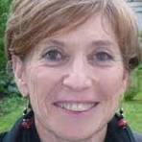
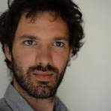
FSD8 organisation: already 2 side-events
How can farming system analysis and design contribute to helping smallholder family farmers in developing countries escape poverty traps
Thank you to Gatien Falconnier (CIRAD), Chloé Maclaren (SLU) and François Affholder (CIRAD), who organized this side event !
New multi-actor organizational forms structuring design processes in territorialized innovation dynamics: towards a research agenda
Thank you to Marianne Cerf (INRAE) and Quentin Toffolini (INRAE), who organized this side event !

Slide 45


WELCOME to the 8th edition of the
Farming System Design Conference
Agronomists
(crop & animal science)
ergonomics
sociology
management
food science
economics
with a shared focus on designing agri-food system transitions
Notes:
Faire animation: aim / community / focus
Insister sur :
Élargir àcommunauté interdisciplinaire et etélargir à agrifood systems !
Theories and practices + North and South

Slide 46
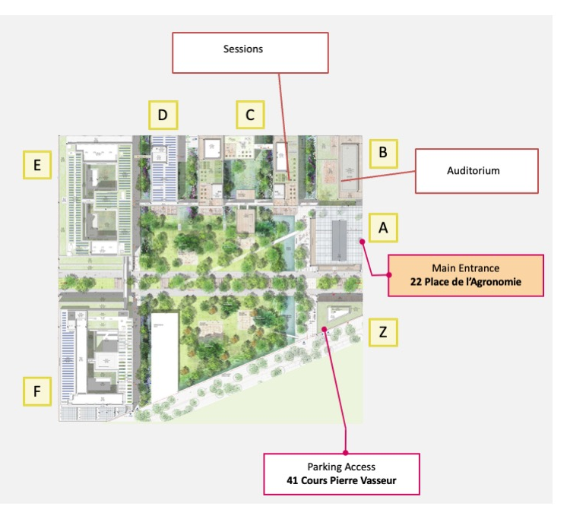
Practical information: map of the campus
You will go there!
You are here now
Find all conference info in the hall:
program
session rooms
coffee breaks
meal locations
You came from here
Notes:
Marion
Follow the signs around campus to reach the program locations

Slide 47
FSD8 : 228 attendees
Continent | Country | 2025
Europe (196) | France | 146
Europe | Netherlands | 23
Europe | Germany | 9
Europe | Belgium | 8
Europe | Italy | 4
Europe | Sweden | 2
Europe | Denmark | 1
Europe | Ireland | 1
Europe | Spain | 1
Europe | UK | 1
America (10) | Uruguay | 5
America | Mexico | 3
America | Canada | 1
America | USA | 1
Asia (10) | China | 4
Asia | India | 3
Asia | Indonesia | 2
Asia | Lebanon | 1
Africa (10) | Tunisia | 3
Africa | Senegal | 2
Africa | Burkina Faso | 1
Africa | Ethiopia | 1
Africa | Madagascar | 1
Africa | Malawi | 1
Africa | Mali | 1
Oceania (2) | New Zealand | 1
Oceania | Australia | 1
From the 5th continents:
Countries: 27
PhD Students : 46 = 20%
Women/Men : 134/94 = 59% / 41%
Vegetarians :71/228 =31 %
Various disciplines : livestock farming, economics, social and human sciences, food sciences, agronomists
Participating to the Training course or side-events : 41+5+ 16 (LINDDA)
NB les chiffres sont inexacts puisque la liste a changé…mais je propose qu’on laisse comme ça
Notes:
Faire lever les gens dans la salle ??? ➔faire animation

